Slide 2
WebEx Housekeeping
Please keep devices muted during the presentation.
Sign-in using the Chatbox feature and elect everyone from the drop-down menu.
Ask questions at any time during the presentation utilizing the chat. Questions will be addressed at the end of the presentation. Select everyone from the drop down.
All formal responses to questions will be provided via an Addendum.
Audio only attendees may follow along on the presentation that has been posted to the SAWS solicitation website.

Slide 3
Oral Statements
Oral statements or discussion during this Pre-Submittal Meeting will not be binding, nor will they change or affect the RFQ or the terms or conditions of the contract. Changes, if any will be addressed in writing only via an Addendum.

Slide 4
Agenda
Objective
SMWB Requirements
Selection Process
Evaluation Criteria
Submission Reminders
Key Dates
Submittal Deadline
Communication Reminders
Background
Project Scope
Questions

Slide 5
Objective
SAWS is requesting Statements of Qualifications from interested firms in connection with the Dam Improvements Project, which will require the scope of services to be performed by a qualified professional engineering firm
SAWS owns multiple dams in San Antonio and the intention of this project is to assess existing conditions, determine dam hazard classification(s), and identify and implement required improvements to ensure safety and compliance with all applicable regulatory requirements
Required engineering services include: planning, evaluations, studies, reports, preliminary engineering, design, bid, construction, start-up/commissioning, and overall project management services

Slide 6
Aspirational SMWB Goal
Industry | Aspirational SMWB Goal | Description
Engineering and Other Professional Services | 40% * | Points assessed on tiered scale
* 40% of the value of the contract.

Slide 7
SMWB Requirements
SMWB Certification accepted from the following entities:
South Central Texas Regional Certification Agency (SBE, MBE, WBE)
Texas H.U.B.
RFQ Scoring:
Local Office
Small Business Enterprise (SBE) certification required for all SMWB firms, including Minority and Woman-owned businesses.
Need lists of SCTRCA-certified firms? Please contact the SMWVB Program Manager at marisol.robles@saws.org with the scopes of work you intend to subcontract.

Slide 8
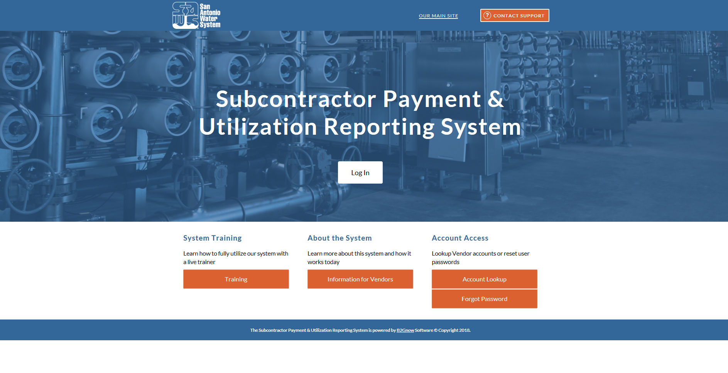
Post Award: Subcontractor Payment & Utilization Reporting (S.P.U.R.) System
WWW.SAWS.SMWBE.COM
Track actual payments to all subconsultants
Request changes to team
Contractual Requirement

Slide 9
SMWVB Questions
Questions related to the SMWVB Program, the Good Faith Effort Plan (GFEP), or finding certified subconsultants may be directed to the SMWVB Program Manager until the RFQ is due.
Marisol V. Robles
SMWVB Program Manager
Email: Marisol.Robles@saws.org
Telephone: (210) 233-3420

Slide 10
Selection Process
Qualification statements reviewed for responsiveness
Technical Evaluation Committee scores qualification statements based on evaluation criteria published in the RFQ
Interviews held, if necessary
Good Faith Effort Plan evaluated and scored
Selection Committee reviews scores and recommends firm(s)
Negotiation with selected consultant(s)
Board Award

Slide 11
Selection Process
If there is a change to key team members (prime or sub-consultant) identified on Respondent’s organizational chart, notify SAWS in writing as soon as possible
SAWS may allow Respondent to replace the key team member with an alternate member who possesses equal or better qualifications and experience
Also, per SAWS’ Ethics Policy, a former SAWS employee may not serve in a lead role as a key team member and/or participate in the negotiation of a contract for two (2) years after separating from SAWS
This may result in the Respondent’s proposal being found non-responsive or a reduction in points during the evaluation

Slide 12
Evaluation Criteria
Criteria | Max Points
Team Experience and Qualifications | 30
Similar Projects and Past Performance | 30
Project Understanding and Approach | 25
Small, Minority, Woman, and Veteran-owned (SMWVB) Business Participation | 15
Total | 100

Slide 13
Evaluation Criteria – Team Experience and Qualifications 30 points – Refer to Attachment II (Description 1)
Organizational Chart – 1-page
Identify all proposed Key Personnel and Key Sub-consultants
Key Personnel to include:
Project Manager
QA/QC Lead
Technical Leads (e.g., dam condition assessment, breach analysis, structural design, site/civil design, electrical and I&C design, hydraulics, geotechnical, etc.)
Lead Estimator
Lead Scheduler
Permitting Lead

Slide 14
Evaluation Criteria – Team Experience and Qualifications 30 points – Refer to Attachment II (Description 2)
Resumes for each proposed Key Personnel – 1-page each / 6 page limit
Name, title, education, description of qualifications, associations, number of years with current firm, and total number of years of professional experience
Brief overview of professional experience and expertise
Three (3) similar projects completed in the past ten (10) years
Detailed description of capabilities and project experience
Role in project relevant to Scope of Services in this RFQ
Clearly identify whether each project listed are with the current firm or part of the individual’s professional experience
All Active projects (including 2022) and percentage of time allocated to those projects

Slide 15
Evaluation Criteria – Team Experience and Qualifications 30 points – Refer to Attachment II (Descriptions 3 & 4)
Describe the composition of the team – 1 page
Prime, Key Sub-consultants, and other Sub-consultants’ roles and responsibilities, as well as teaming history
Table Matrix in Attachment II – Fillable Form
Availability and percentage of time committed to contract of Key Personnel and Geographic location

Slide 16
Evaluation Criteria – Similar Projects and Past Performance 30 points – Refer to Attachment II (Description I)
Three (3) current and/or previous relevant projects in the last ten (10) years in which Respondent has performed services similar to those sought in this RFQ
Use fillable forms, Project Tables, one per project reference
Minimum of two (2) shall have been performed by the Respondent.
Maximum of one (1) projects shall have been performed by Key Subconsultant (or by Respondent if no Key Subconsultant)
Technical Leads shall have participated in at least two (2) projects.
Other Key Personnel (Not PM) shall have participated in at least one (1) project.

Slide 17
Evaluation Criteria – Similar Projects and Past Performance 30 points – Refer to Attachment II (Description I) (Cont’d)
Information for each Project Reference shall include:
Name of utility owner and geographic location
Reference contact information (name, title, phone numbers and email)
Year, duration of project, NTP, and completion date
Detailed description of project
Explanation why project is similar to SAWS scope
Respondent’s role and Key Personnel responsibilities including subconsultant

Slide 18
Evaluation Criteria – Similar Projects and Past Performance 30 points – Refer to Attachment II (Description 2)
Provide cost information for total of five (5) projects including the three (3) submitted as part of Description 1
Shall relate to the accuracy of the OPCC, comparing the Engineer’s 100% design estimate to approved construction contract awards
Use fillable form
Provide all project data being requested
N/A is not an acceptable response

Slide 19
Evaluation Criteria – Project Understanding and Approach 25 points – Refer to Attachment II (Description I)
Detailed approach describing how Respondent will technically execute and complete services sought in this RFQ on time and within budget
Innovative approaches, ideas, and recommendations
Five (5) page limit
One (1) 11”x17” Exhibit allowed (not counted towards page limit)

Slide 20
Evaluation Criteria – Project Understanding and Approach 25 points – Refer to Attachment II (Description 2)
Provide answers to the following:
Familiarity with similar facilities, infrastructure, and Project areas
Approach to becoming familiar with local and regional market conditions influencing the design and construction decisions impacting cost
Understanding of coordination requirements with the involved entities/ agencies, responsiveness, and follow through
Approach to preparing deliverables to meet deadlines without compromising quality and schedule
Schedule recovery approach relative to schedule maintenance
Identify Project risks and approach for mitigating impacts from those items
Regulatory and permitting agency coordination to ensure approval
Two (2) page limit

Slide 21
Evaluation Criteria – Project Understanding and Approach 25 points – Refer to Attachment II (Description 3)
Project specific and unique quality control and quality assurance (QA/QC) and risk management strategies that Respondent engages in for similar projects
Plan for how issues will be identified, tracked, and resolved
How the independent QA/QC Lead will review project deliverables to ensure the Project is of high quality, biddable, permittable, constructible, operable, maintainable, and cost-effective
Respondent’s role compared to SAWS role
Describe how accuracy and completely of OPCCs are derives for each design phase and familiarity with AACE’s Recommended Practices
Familiarity with use of RS Means for construction change order estimates
Two (2) page limit

Slide 22
Submission Reminders
Thoroughly read the RFQ to become familiar with scope
Scope for this RFQ is for professional engineering services for Dam Improvements Project.
Be specific and avoid “boiler plate” responses where narrative is requested
Address ALL items as requested for each evaluation criteria
Contact the SMWVB Program Manager for assistance, if necessary
Ensure projects are similar to the scope in this RFQ
Project references provided shall have been verified by Respondent and are readily accessible

Slide 23
Submission Reminders
SAWS is accepting electronic copies only
File size limited to 10 MB and 23 pages
Reference RFQ regarding required items that do not count towards the page limit
Utilize the Submittal Response Checklist
Must submit using Evaluation Criteria Forms, where indicated
8½”x11” portrait format, 11”x17” allowed for graphical exhibit
Perform QA/QC on proposal prior to submitting
Solicitation Submittal Tips found at the following link: https://apps.saws.org/business_center/ContractSol/SNO_Drill.cfm?id=1980&View=Yes

Slide 24
Key Dates
Action | Date/Time*
Written Questions Due | May 24, 2022 by 4:00 p.m.
Q & A Posted to Website | May 31, 2022 by 4:00 p.m.
Proposals Due | June 7 2022 at 10:00 a.m.
Proposals Evaluated | June 2022
Interviews, if necessary | June 2022/July 2022
Negotiations | July 2022
SAWS Board Consideration and Award | August 2, 2022
Start Work | August 2022
* The dates listed above are subject to change without notice

Slide 25
Submittal Deadline
SAWS will accept electronic submittals only
Allow sufficient time to upload submittal ahead of the deadline to allow for any technical difficulties
Solicitation number, solicitation name, date and time of the deadline should be clearly identified on the electronic file and email
Late responses will not be accepted and will not be opened

Slide 26
Communication Reminders
There should not be any communication regarding this solicitation with the following:
SAWS Project Manager
Any other SAWS staff, managers, directors, or VPs
City Council member or staff
SAWS Board of Trustees
This includes phone calls, emails, letters, or any direct or indirect discussion of the RFQ
This is in place from release of the RFQ to Board Award

Slide 27
Background – Scope
Disciplined implementation of processes and procedures
Understanding of scope
Coordination with subs
Deliverables (reports, plans, specs, OPCC, etc.)
Perform internal quality management including control and assurance prior to submitting design deliverables to SAWS in accordance with the Quality Management Plan (QMP)

Slide 28
Background – Schedule
Right amount of time allocated
Plan ahead
QA/QC
Alignment between schedule and importance of task

Slide 29
Worrying about what we can control…
Sound and disciplined Project Management
Communicate effectively
Plan for success
Emphasis on Quality, Completeness, and Clarity of Contract Documents
Design and construction schedule
QMP adherence
QA/QC of sub-consultants’ work

Slide 30
Worrying about what we can control…
Design review workshops at every milestone
Site visits and walk-throughs
Manage schedule to our advantage
Timing
Team effort
Adhere to the process
OPCCs are very important

Slide 31
Project Scope
SAWS anticipates awarding one or more work order type contracts encompassing one or more facilities to qualified consultants from this RFQ
Specific construction elements will be determined pending condition assessments of the dam(s)

Slide 32
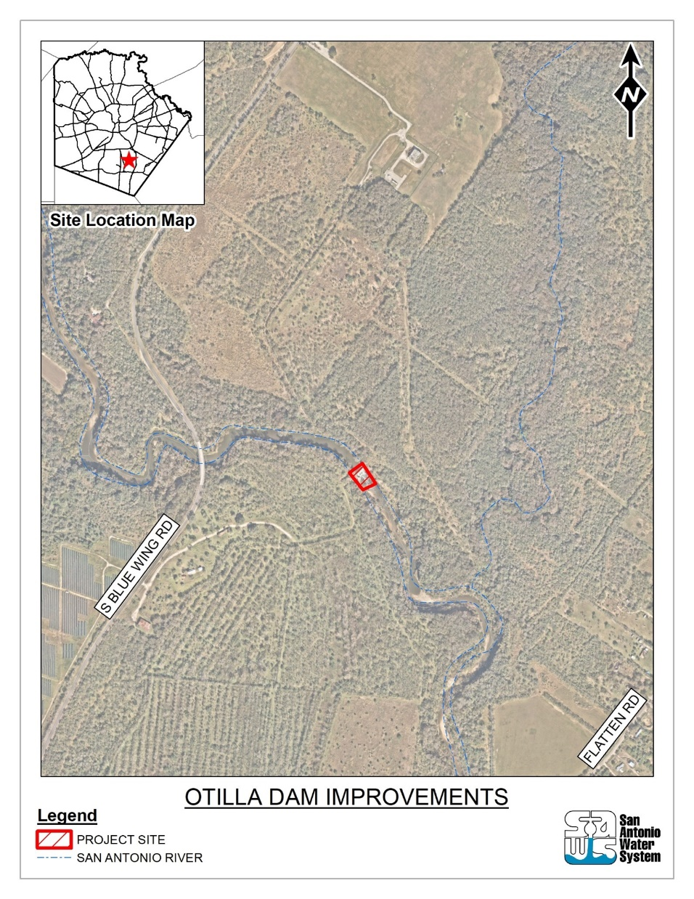
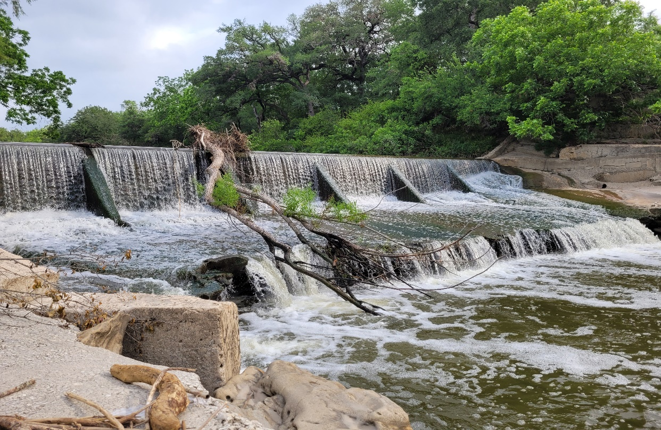
Project Scope
Otilla Dam is one dam identified by SAWS to be included as part of this project

Slide 33
Project Scope
Condition Assessment
Breach Analysis
Engineering studies/reports, including geotechnical investigation
Dam Hazard Classification
Identification and design of required and recommended improvements

Slide 34
Project Scope
Milestones
Dam Assessment and 10% Design Phase
30% Design
60% Design
90% Design
100% Design and Bid Phase
Construction Phase
Prepare Engineer’s OPCC at each milestone
Cost estimate shall be a Class 3/2/1 Estimate as described in the Association of the Advancement of Cost Engineering (AACE) Recommended Practice No. 17R-97 and 56R-08

Slide 35
Questions
Must be submitted in writing by May 24, 2022 by 4:00 P.M. via e-mail to:
Susan Rodriquez
Contract Administration Department
San Antonio Water System
Susan.Rodriquez@saws.org

